Slide 1
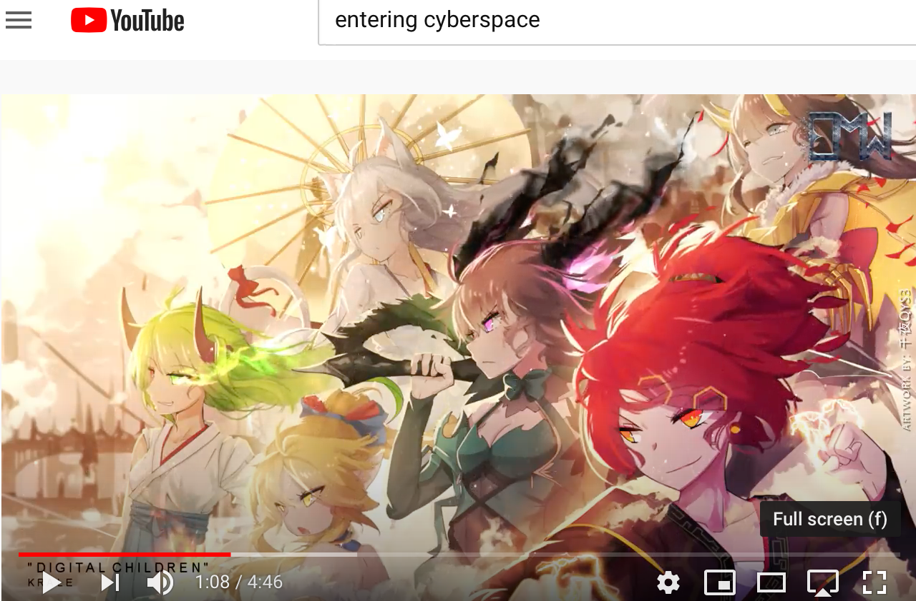
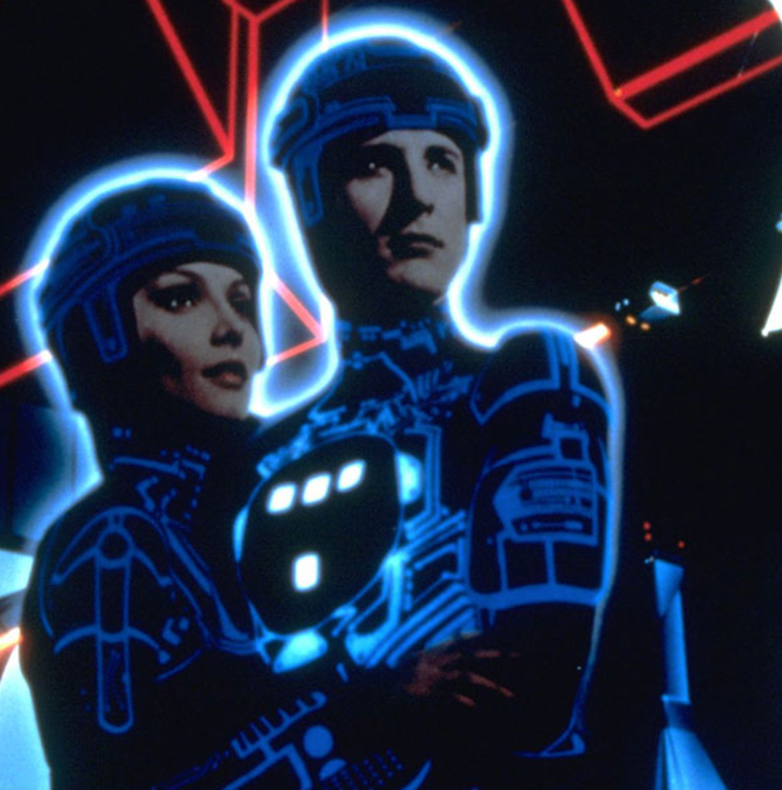
Zoom Q&A Session: Module: As Class Begins…: On How to Accomplish Online Economics Education
Time: Tu Aug 25 15:30 PDT. Zoom URL: TBA.
Questions:
What, at the end of the semester, will we wish we had done today in terms of structuring this course? (I want three suggestions.)
We know of Sokrates’s uneasiness about books as opposed to in-person teaching only because Plato wrote a… book; how did Plato write his book in an attempt to get around Sokrates’s objections to the idea of teaching via making people read books?
How does Andy Matuschak hope to build websites—and author books—that will be easy to read well?
Even by people who are not (or not yet) good active readers
How are we to train you to become good active readers?
What does Partha Dasgupta think “thinking like an economist” is?
How is it different from what you were taught in Econ 1? How is it the same?
Is his Economics: A Very Short Introduction properly titled? Should it instead have been called: The Economy: A Very Short Introduction?
In the way of assignments for this course, what else should we be asking people to do, in addition to weekly participation in the threaded discussions, weekly problem sets, & a final paper?
Where in the staggered module flow process we instructors have set up are things likely to go wrong?
Music for Entering Cyberspace: "DIGITAL CHILDREN" by @Krale <https://www.youtube.com/watch?v=goks2xcpH0o>
80 min zoom q&a session (starts 15:30 PDT Berkeley time—i.e. 15:40)

Slide 2
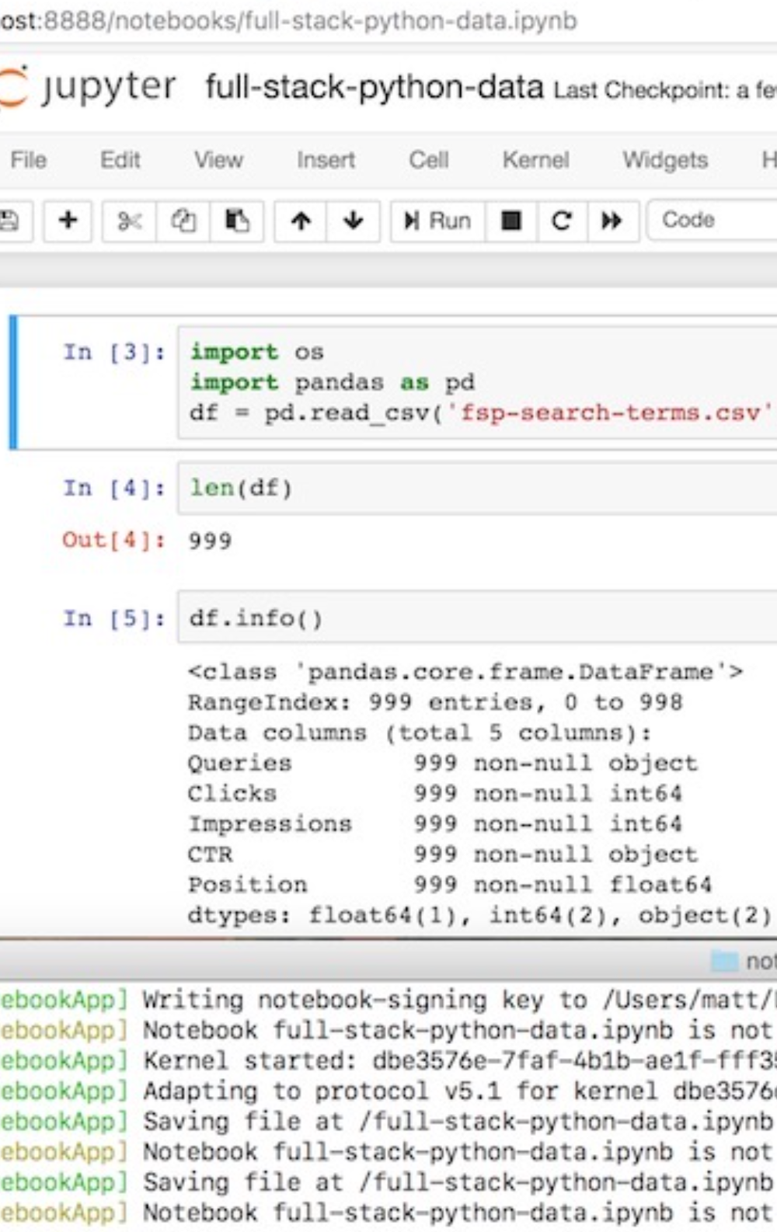
Do Jupyter Notebook…
Unwritten…
JUPYTER NOTEBOOK URL: TBA
UNFINISHED: NOTEBOOK UNWRITTEN
Notes:
Let me tell you my first bottom line. When—if—20 years from now, you find yourself thinking or mentioning that you took Brad DeLong’s U.C. Berkeley course on 20th Century Economic History, I want you to think: He said that he thinks that it is more likely than not that the Long 20th Century 1870-2016 will be seen for centuries or millennia into the future as the watershed in human experience—analogous to the century of the invention of agriculture, or the discovery of fire.
He said that humanity is unlikely to see as transformative—for good and for ill, but mostly for good, so far at least, I think—a century again, at least not until some future era that he could not imagine.
He said that the key is that humanity managed to start inventing and applying technology—better ways of manipulating nature and of organizing people—so that our collective power per capita to produce useful commodities began to double every generation. He said that such a pace of inprovement was more than four times that of any previous century; at least twelve times that of any pre-Industrial Revolution era; and fifty times that of the long agrarian age between ten millennia and two and a half centuries ago. And he said that the use of humanity’s growing technological power shifted, after a brief but significant population explosion to our current numbers of near ten billion, from allowing more of us to live on the globe in poverty without starving to death to enabling rapid if ill-distributed growth in real incomes.
Then I hope you will think: And he said that there were ten aspects and ramifications of the watershed that was the Long 20th Century 1870-2016. What were they? And I hope you will be able to pull some of them up.
You won’t remember all ten—although I very much hope you will remember a bunch of them, and if someone tells them back to you you will think “oh yeah…”.

Slide 3
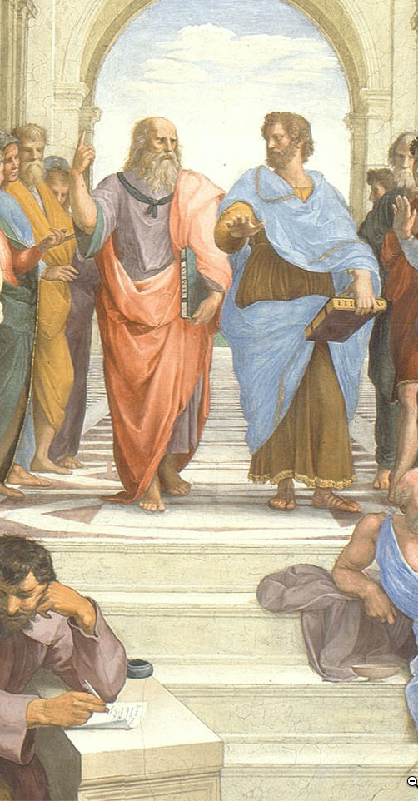
Discuss: As Class Begins… Module…
Let me start this discussion off by asking three questions:
Did the “Introduction to Jupyter Notebooks” assignment “work” for you?
What are our chances of making this course a fully worthwhile educational experience for you? What is the most essential thing to make sure we accomplish?
What important pieces of history is this economics-centered course likely to overlook? How is that going to make this course less worthwhile than an ideal course would be?
As before, for full credit for this discussion, provide at least two substantive contributions to the discussion, of which at most one should be a direct response to one of my questions. We want you to talk to & react to one another here…
THREADED DISCUSSION URL: <https://bcourses.berkeley.edu/courses/1493152/discussion_topics/5774299/>
130 words

Slide 4

Learning Goals for: Module 0. As Class Begins…
Six primary:
To be able to outline how a typical week’s module of this course will work
To be able to outline why we have chosen this course structure in our attempt to provide a better-than-3rd-class online education here
To critique, in an informed way, our structural choices
To be able to outline what “thinking like an economist” is good for
To be able to outline course requirements and resources
To be able to successfully complete a jupyter notebook problem set
Six secondary:
To explain to classmates why the instructors chose Andy Matuschak: Why Books Don’t Work as the first required reading for this course.
To be able to suggest an alternative first reading that, in their informed opinion, might have been a better choice given the aims of this course and this module
To explain to classmates why the instructors chose Partha Dasgupta: Economics: A Very Short Introduction as the second required reading for this course.
To be able to suggest an alternative second reading that, in their informed opinion, might have been a better choice given the aims of this course and this module
To formulate a plan for how to get the most educational juice out of this—very odd—semester
To have communicated with the instructors with respect to potential obstacles—financial, technological, or otherwise—to fully participating in all the activities of this course
Link
Link
240 words

Slide 5
Catch Our Breath…
Ask a couple of questions?
Make a couple of comments?
Any more readings to recommend?
<>

